Slide 1
Anime Recommendation
Data Analysis
Project
Rawan Hisham Neiazy 202001119
Shahd Ayman Abdullah 202002096
Marvy Ashraf Lamei 202001987
Nouran Ahmed Mahmod 202000574
Farah Amr Mohamed 202001483

Slide 2
Problem Defination
In order to provide good recommendation services to users, it is critical to understand how they describe their needs when looking for an anime. So we provide this program that recommends movies based on the type of animes that the user is watching, and it filters a movie that is similar or similar to the type of movies that they are watching.

Slide 3
Used Dataset
kaggal is the source of our dataset. https://www.kaggle.com/datasets/snehaanbhawal/anime-list-for-recommendation-system-june-2021

Slide 4
preparation and preprocessing
01
+First we get the data from kaggle
+Second we start to understand and visualize our data
+Third we cleaned the data as we remove null values and outliers

Slide 5
Methods
We used bulid-in libraries:
import pandas as pd
import numpy as np
import matplotlib.pyplot as plt
import seaborn as sns

Slide 6
Conclusion
The analysis I conducted is meant to guide someone who is new to anime and assist them in being able to propose a few shows to get them started. Future research may involve developing a recommendation system based on user reviews.

Slide 7
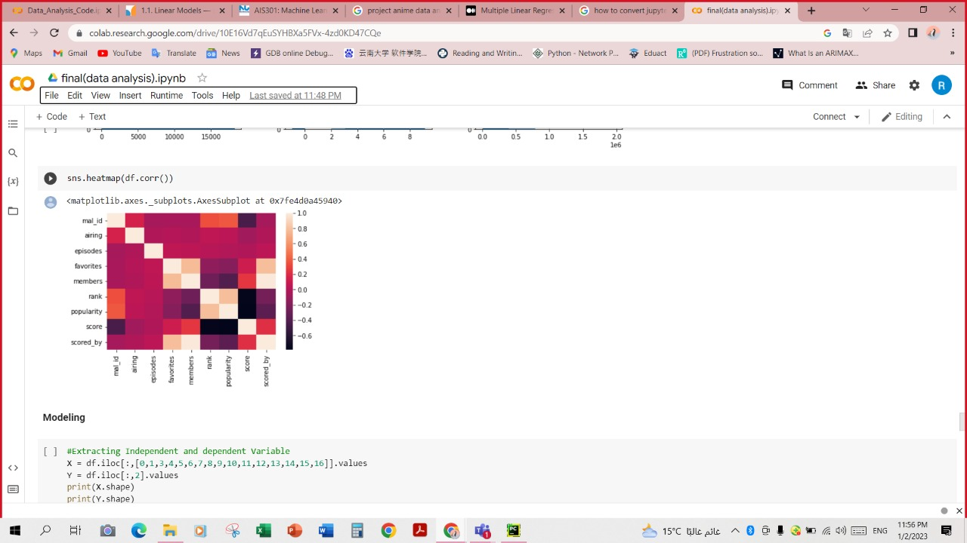
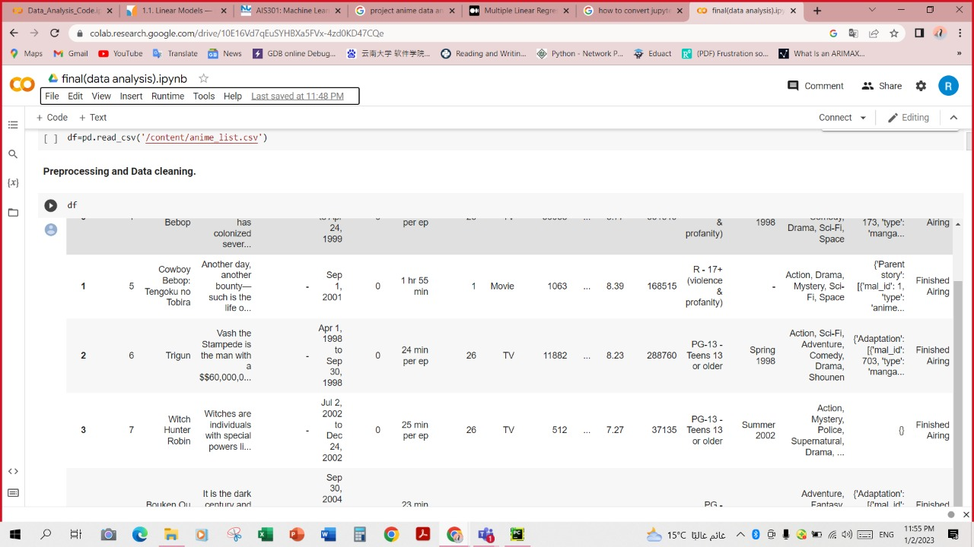
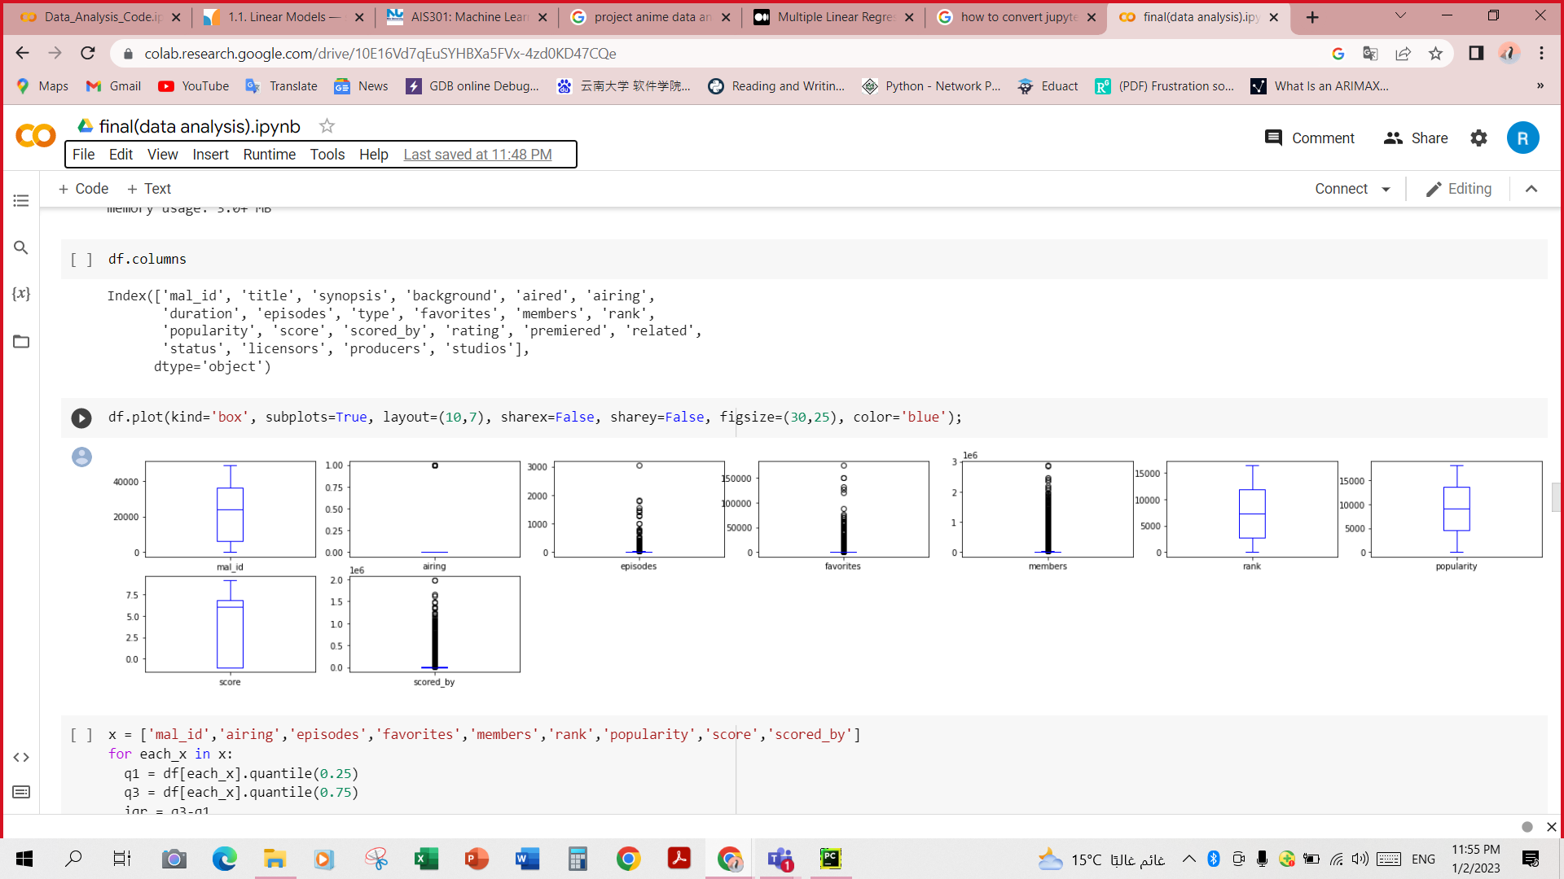
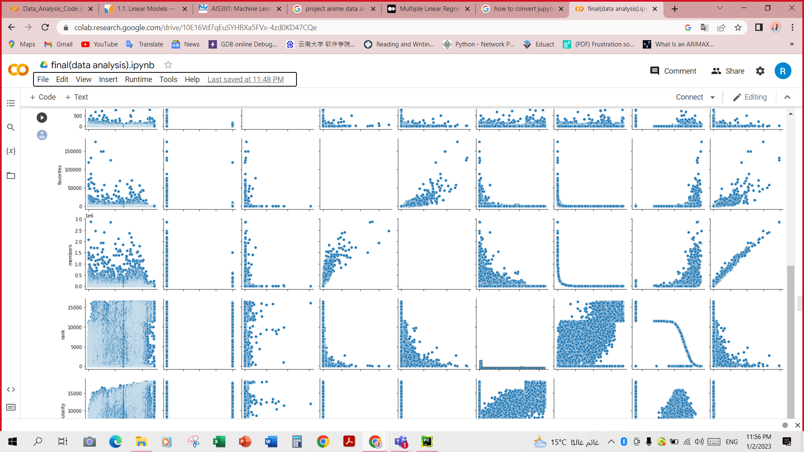
Results

